Slide 1

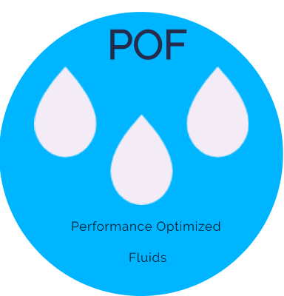
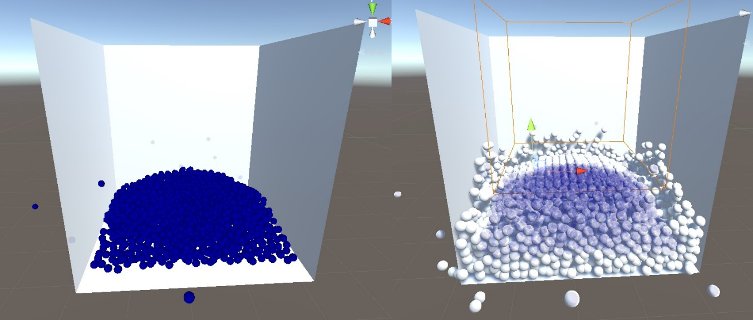
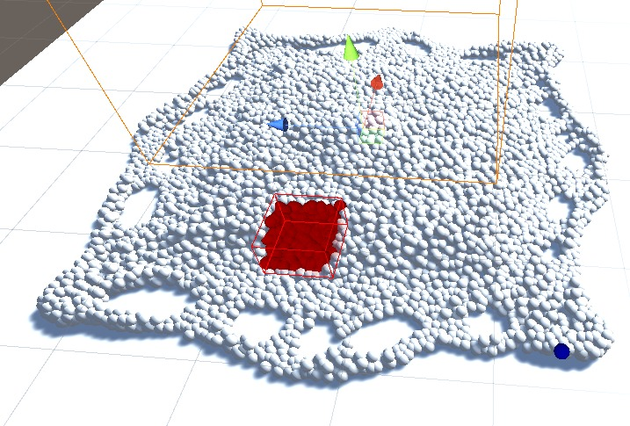
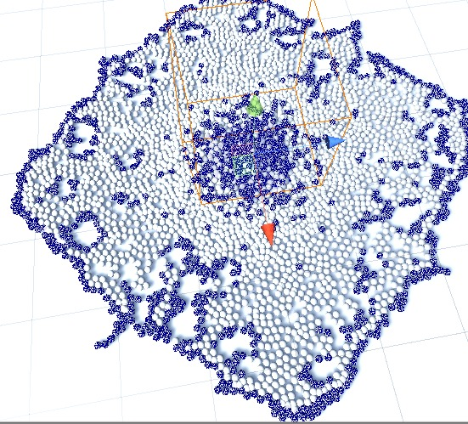
Performance Optimized Fluids
Baran Budak, Cihanser Çalışkan, İsmail Mekan Supervisor: Mehmet Ufuk Çağlayan Advisor: Gizem Kayar
Aim
The POF project based on researching particle-based fluid simulation and improving the performance of the particle-based fluid simulation. Increasing the effectiveness and performance of a particle-based fluid simulation is a primary aim. These goals achieved by implementing algorithms to the POF system such as using special structures to detect and store particles.
Objectives
The project main objective is making research and implementing the methods in the research papers on particle-based fluid simulations. The implementation of these algorithms consists of two main parts in the POF system: Hash system and surface recognition.
In conclusion, the POF project objective is making research and implement to obtain better performance on finding particles and recognizing surface particles on particle-based fluid simulations.
EVALUATION
Fluid simulation is having difficulty with a surplus of particles. POF system increases the performance and simulation can handle more particles. POF system affects memory efficiency so that simulation requires less memory. The spatial hash algorithm has a tremendous benefit in memory efficiency. POF system makes higher frame rates possible. Surface particle recognition eliminates the cells that are not made a calculation. Surface particle cells increase the performance by discarding inactive cells. Performance and efficiency are important elements of particle-based fluid simulation.
Implementation
The implementation is of three main parts: First implementation Hasher benefits to the POF by accessing particles easier. The second implementation is surface recognition which is an algorithm used from Akıncı, G. et al. (2012) [1] to draw vertices of surface particles. The third implementation is written by Zhu, Y. et al. [7], offers an alternative way to simulate liquids.
CONCLUSION
The surplus of particles in a simulation can be a computational hardship for the computer. We implement various methods to get better results by doing research. POF project concentrates on solving computational difficulty problems by increasing performance and efficiency. POF makes easier to simulate with higher quantities of particles or getting better results with the same number of particles by using the hash algorithm and surface particle recognition algorithm.
HASHING
Hashing is a method to mapping particles in a three-dimensional space converted to the one-dimensional hash table that allows very fast access on particles in the 3-dimensional space domain. Hash system analyses particles position data and finds particles faster through a special function.
ZHU AND BRIDSON
The research paper is written by Zhu, Y. et al. [7] offers an alternative to simulate liquids. Zhu, Y. et al. [7] mentions surface reconstruction from particles. It computes a scalar value of vertices that outside of the fluid to send marching cubes to visualize.
SURFACE RECOGNITION
Surface recognition algorithm detects surface particles and the other necessary data about a particle. Surface recognition finds surface particles by calculating the weight value in a ranged area.
Focusing on finding surface particles is necessary for the drawing part in the POF system. Because of the surface recognition component, the POF system works more efficiently and better performance obtained.
REFERENCES
1-) [AIA12] Akinci, G., Ihmsen, M., Akinci, N. and Teschner, M. (2012). Parallel Surface Reconstruction for Particle‐Based Fluids. Computer Graphics Forum, 31, 1797-1809.
2-) [BP94] Paul Bourke 1994, Marching Cubes, viewed 1 December 2019, http://paulbourke.net/geometry/polygonise/
3-) [MCG03] M. Müller, D. Charypar, and M. Gross (2003). Particle-based fluid simulation for interactive applications. In Proceedings of the 2003 ACM SIGGRAPH/Eurographics Symposium on Computer Animation (SCA ’03), 154–159.
4-) [PTB03] Premžoe, S. , Tasdizen, T. , Bigler, J. , Lefohn, A. and Whitaker, R. T. (2003). Particle‐Based Simulation of Fluids. Computer Graphics Forum, 22, 401-410.
5-) [TH03] Teschner, M., Heidelberger, B., Müller, M., Pomerantes, D., and Gross, M.H. (2003). Optimized Spatial Hashing for Collision Detection of Deformable Objects. VMV.
6-) [WH87] Lorensen, William & Cline, Harvey. (1987). Marching Cubes: A High Resolution 3D Surface Construction Algorithm. ACM SIGGRAPH Computer Graphics. 21. 163-. 10.1145/37401.37422.
7-) ZB05] Zhu, Y., & Bridson, R. (2005). Animating sand as a fluid. (New York, NY, USA, 2005) ACM Trans. Graph., 24, 965-972.

